Slide 1
APOLOGETICS
IN ONE LESSON
almost
Ai1L.net
Lesson 4
A-Paul-agetics

Slide 2
Key Takeaways
1
1 Peter 3:15 (“the Apologist’s verse”) emphasizes character over case-making
2
Representing God’s character matters as much as representing the facts
3
A good ambassador uses an artful method in addition to good facts

Slide 3
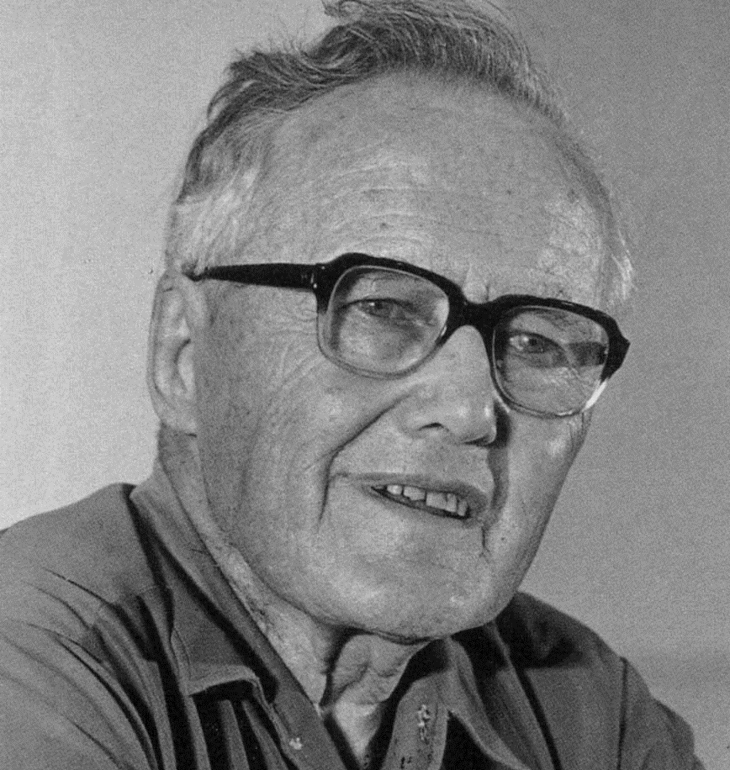
“What would be involved in a missionary encounter between the gospel and this whole way of perceiving, thinking, and living that we call ‘modern Western culture’?”
LESSLIE NEWBIGIN Foolishness to the Greeks: The Gospel and Western Culture (page 1)

Slide 4
Church Attendance
1972-2014 (General Social Surveys)

Slide 5
IDEA IN BRIEF
What?
Recognize and use ideas within the culture to spread the Gospel
Why?
So that we can begin to find aspects of our culture that we can use to spread the Gospel
How?
By considering how Paul used cultural ideas to promote the Gospel

Slide 6
In what ways did Paul act in a gracious to the Athenians?
1

Slide 7
“used to describe people of low class who speak as though they have intelligence”
Jennifer Marie Creamer God as Creator in Acts 17:24: An Historical-Exegetical Study, page 30

Slide 8
“He was a rag-bag collector of scraps of learning.”
Bruce Winter Introducing the Athenians to God: Paul’s failed apologetic in Acts 17? Themelios volume 31, issue 1, page 39

Slide 9
Describe Paul’s argument he makes in 17:24-27. Why this is significant?
2

Slide 10
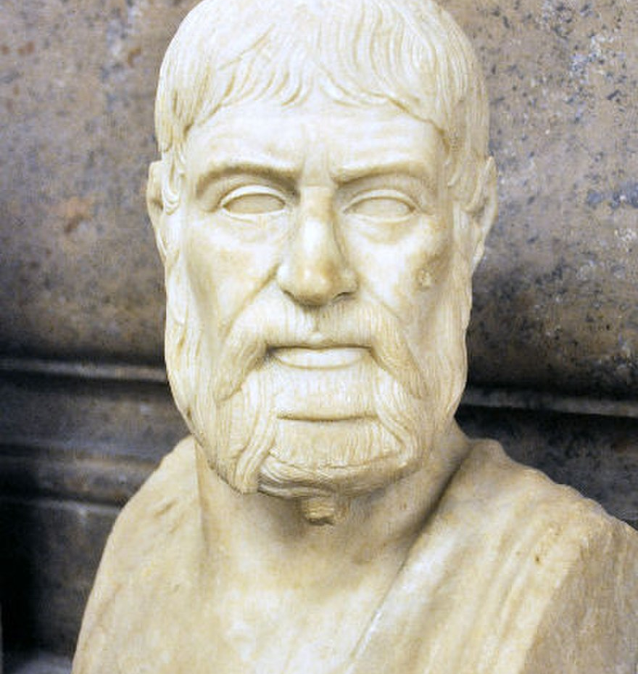
“…the Athenians are far more devoted to religion than other men”
PAUSANIAS Description of Greece

Slide 11
“If the Council were so persuaded, then the god or goddess would be admitted to the Parthenon. A dedicated temple would be built to the divinity, an annual feast day endowed and included in the Athenians’ religious calendar.”
Bruce Winter Introducing the Athenians to God: Paul’s failed apologetic in Acts 17? Themelios volume 31, issue 1, page 41

Slide 12
Athenians | Paul
A special day | Mankind’s seasons are set by God (17:25)
Temple | You dwell in him (17:28)
Introducing a new God | Not a new God, and you need to be introduced to him (17:30)
They are the judge | God judges you (17:31)

Slide 13
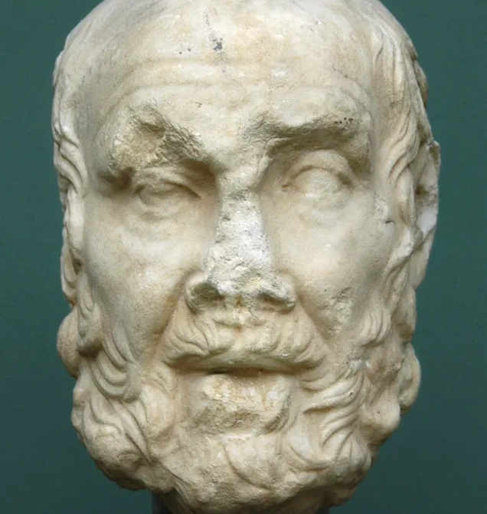
“Thee it is meet that mortals should invoke, For we Thine offspring are, and sole of all Created things that live and move on earth Receive from thee the image of the One.”
CLEANTHES OF ASSOS Hymn to Zeus (translated by E. H. Blakeney)

Slide 14
“How great Thou art, The Lord supreme for ever and for aye! No work is wrought apart from Thee, O God, Or in the world, or in the heaven above, Or on the deep, save only what is done By sinners in their folly.”
CLEANTHES OF ASSOS Hymn to Zeus (translated by E. H. Blakeney)

Slide 15
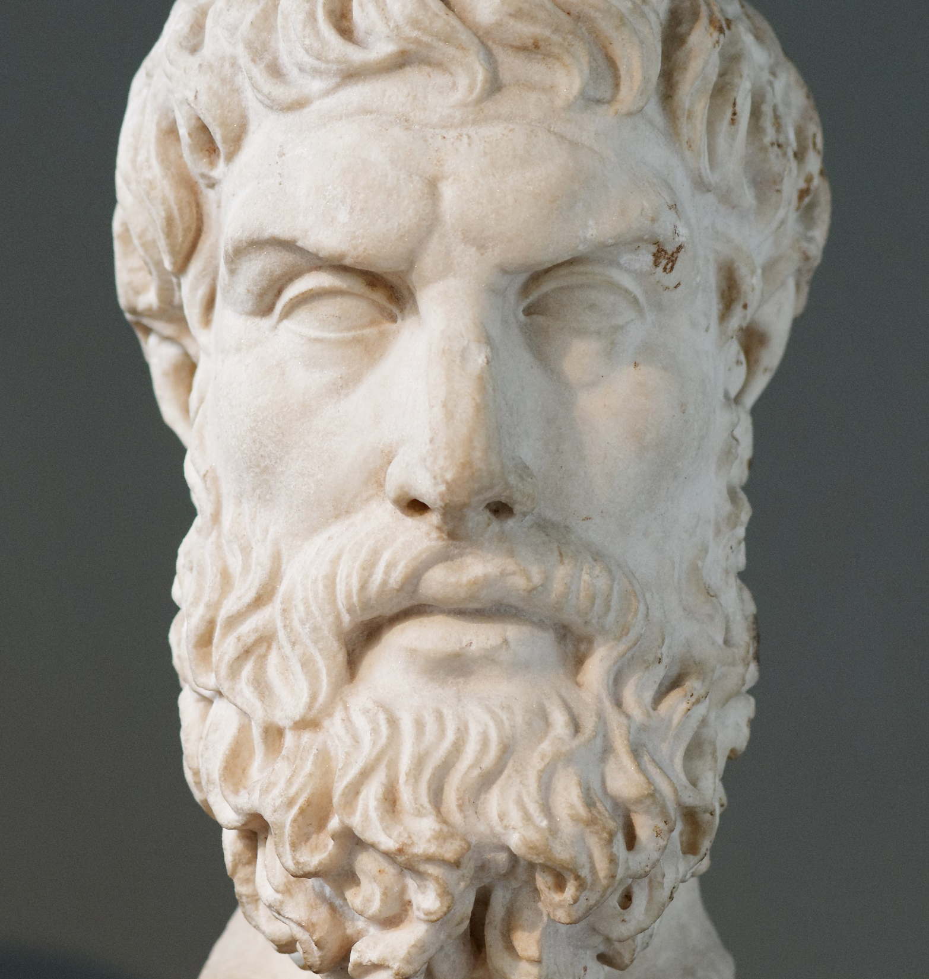
“God had no need of human resources”
PHILODEMUS On Piety, fr 38

Slide 16
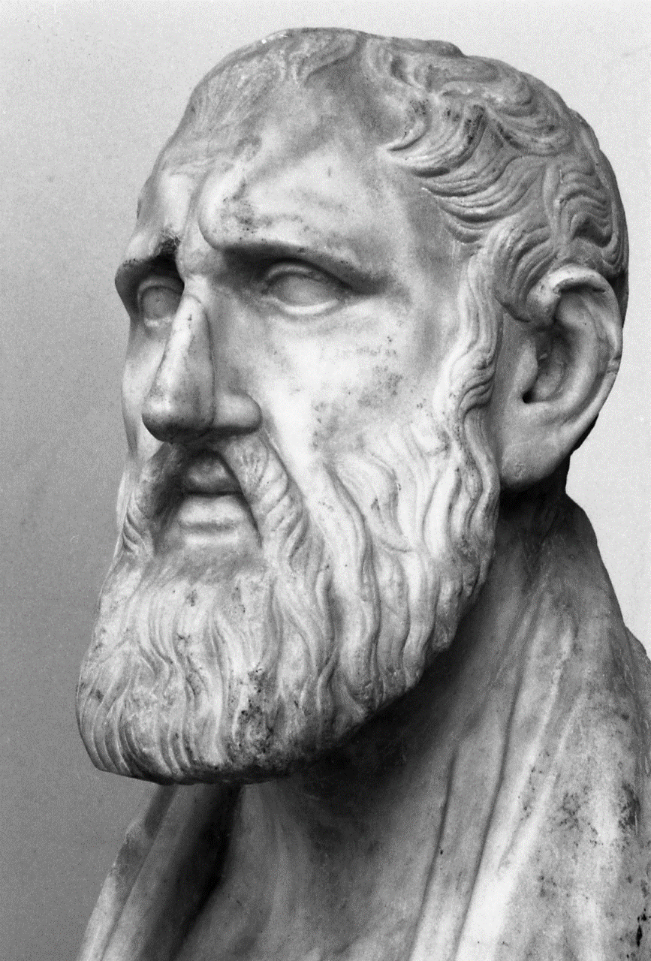
“first they prove that the gods exist; next they explain their nature; then they show that the world is governed by them; and lastly that they care for the fortunes of mankind.”
BALBUS Cicero, De Natura Deorum, II.3

Slide 17
Balbus | Paul
God exists | “made the world and everything in it…” (17:24a)
World is governed by them | “He Himself gives all men life and breath and everything else” (17:25b)
Cares for the fortunes of mankind | “determined their appointed times and the boundaries of their lands” (17:26)

Slide 18
List out ways in which Paul adjusted his approach for the Athenians.
3

Slide 19
“First believe that God is living, immortal and blessed”
1 Thess. 1:9
Romans 1:23
1 Tim. 1:11
Epicurus (in a letter to Menoeceus) Lives of Eminent Philosophers, 10.123

Slide 20
“line 200 prohibits the building of temples, law courts and gymnasia in cities.”
ZENO OF CITIUM (FOUNDER OF STOICISM) Lives of Eminent Philosophers (7.1, line 133)

Slide 21
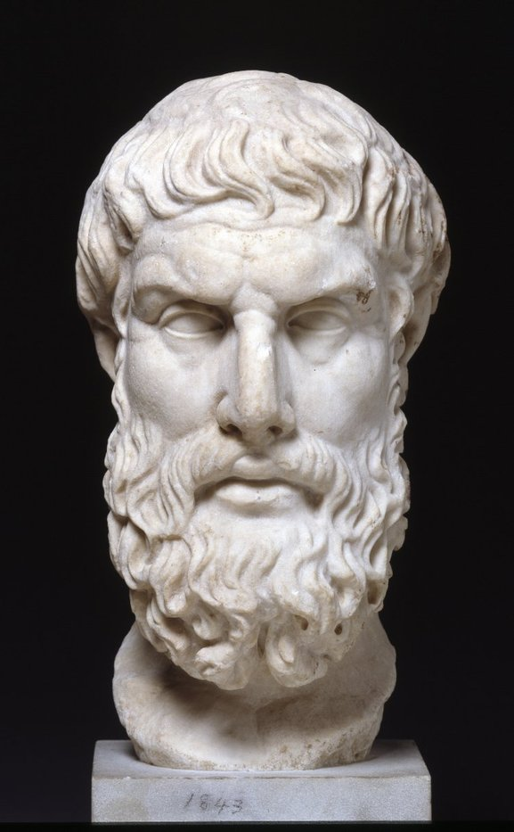
“For the utterances of the multitude about the gods are not true preconceptions but false assumptions”
EPICURUS (FOUNDER OF EPICURISM) Lives of Eminent Philosophers (10, line 124)

Slide 22
“People are generally better persuaded by the reasons which they have themselves discovered than by those which have come into the mind of others”
BLAISE PASCAL Pensées

Slide 23
What is the argument that Paul uses against idolatry? Why would this argument be persuasive?
4

Slide 24
In what ways in which Paul showed courage?
5

Slide 25
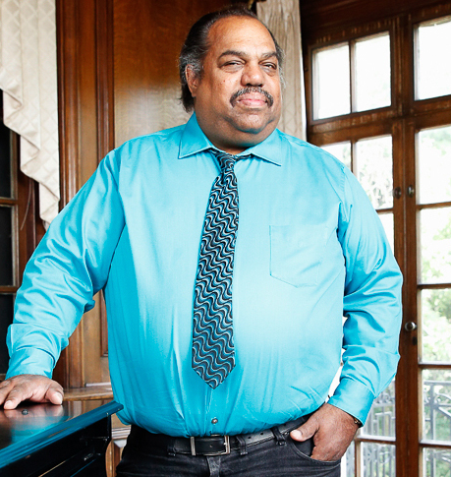
“what good is it when you complain about racism to people who already agree? You are literally preaching to the choir.”
DARYL DAVIS

Slide 26
Want can we learn from the response to Paul’s message?
6

Slide 27
“Now when they heard about the resurrection from the dead, some began to scoff, but others said, “We will hear you again about this.” So Paul left the Areopagus. But some people joined him and believed.”
Acts 17:32-34

Slide 28
Was there anything else that stood out to you?
7

